Slide 1
Image classification using CNN Link to Video Presentation - https://youtu.be/C9Pgvgxu1Is
Kavya Chowdary Immanni
Naga Prasad Kondaboina
Chandrasekhar Naidu Seelam

Slide 2
CONTENTS
Abstract
Introduction
Goal and purpose
Proposed system
Design
Algorithm used in the proposed system
Methodology
Applications and Advantages of CNN
Results and conclusion
Future Enhancements
References

Slide 3
ABSTRACT
Identifying and classification of images using CNN has many real-world applications here we developing a simple model that can identify images and categorize them into different class objects which can help with the education process of children.
CIFAR-10 is a well-known collection of images used to train and evaluate machine learning algorithms for image recognition. It comprises 60000 colored images categorized into 10 groups with each group having 6000 images.
In this project, we demonstrated how to train two different models to classify images in the CIFAR10 dataset – a Random Forest classifier and a CNN model.
Keywords- Convolution Neural Network, Machine Learning, Image Preprocessing, Feature Extraction, Segmentation.

Slide 4
INTRODUCTION
Image classification comes under the field of computer vision and machine learning. Computer vision is a subfield of artificial intelligence (AI) that focuses on enabling machines to interpret, analyze, and understand visual information from the world around them.
Machine learning algorithms such as deep neural networks, random forests, and support vector machines are used to learn patterns and features from labeled training data, and then use those patterns to classify new images. For example, a deep convolutional neural network (CNN) can be trained on a large dataset of labeled images, and the network can learn to identify patterns and features in the images that are associated with particular classes. Once the network is trained, it can be used to classify new images based on their visual content.
Computer vision techniques such as edge detection, feature extraction, and image segmentation are used to identify and isolate meaningful visual features in images that can be used to distinguish between different classes. For example, edge detection can be used to identify the edges of objects in an image, while feature extraction can be used to extract texture, shape, and color information from different regions of an image.

Slide 5
Goal and Purpose:
The main goal of an image classification project using CNN and comparing the accuracy with the random forest ensemble approach on the CIFAR-10 dataset is to develop a CNN model that can accurately classify images into one of the 10 classes in the CIFAR-10 dataset.
The CNN model should be able to learn the relevant features from the input images and use them to accurately predict the class label of the image. The model should also be able to generalize well to new images that are not part of the training dataset.
In addition to achieving high accuracy, other future project goals may include optimizing the hyperparameters of the model to improve its performance, interpreting the trained model to understand how it makes predictions, and deploying the model in a production environment for inference.

Slide 6
PROPOSED SYSTEM
In the proposed system, a CNN-based model is used to recognize the images. The model consists of four parts: importing the image dataset, image preprocessing, image normalization, training the model using CNN, uploading the image, and prediction.
Initially, we load the CIFAR-10 dataset from keras.datasets module After loading the dataset, we perform preprocessing on it by splitting the dataset into training and testing datasets. Later, we train our model using CNN. Then, we predict or identify any image which is passed through cv.imread belonging to respective labeled classes on which model is trained.

Slide 7
DESIGN
Data Preprocessing
Split the dataset into training and testing sets
Load Dataset
Train Random forest classifier
Train Convolutional neural network
Evaluate classifier Performance (Accuracy, precision, recall)
Load the image on the best model to predict the label

Slide 8
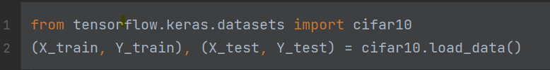
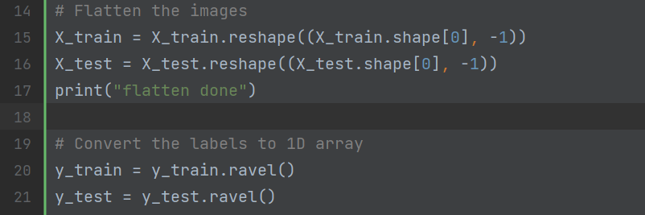
METHODOLOGY
Random Forest:
Data collection from the trained datasets
Flattening the images and converting labels to 1D array

Slide 9
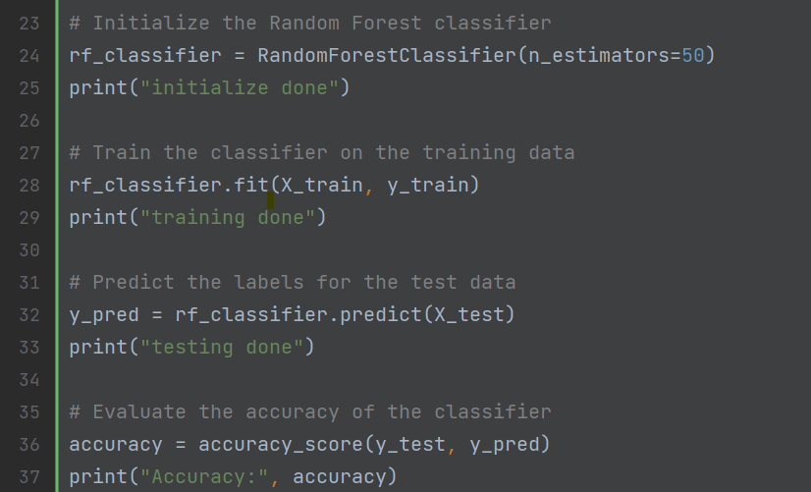
METHODOLOGY
Building and Training Random forest Classifier

Slide 10
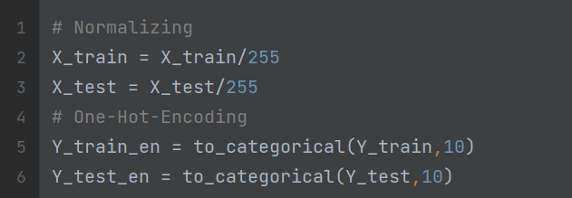
METHODOLOGY
CNN:
Data collection from the trained datasets
Pre-processing of images

Slide 11
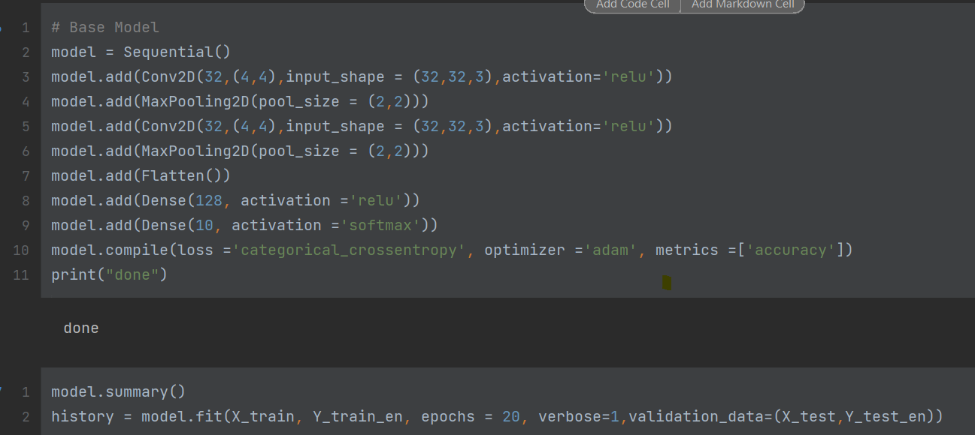
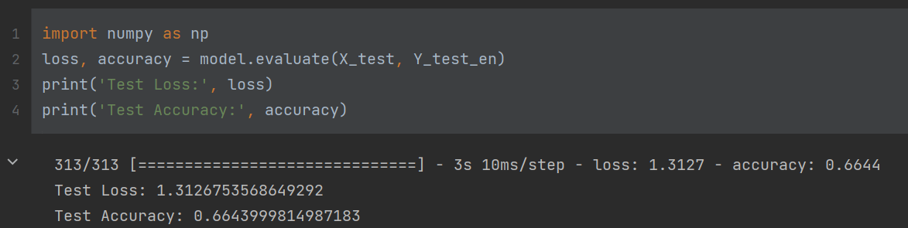
METHODOLOGY
Building and Training CNN classifier (Initial Base Model Accuracy 66.4%)

Slide 12
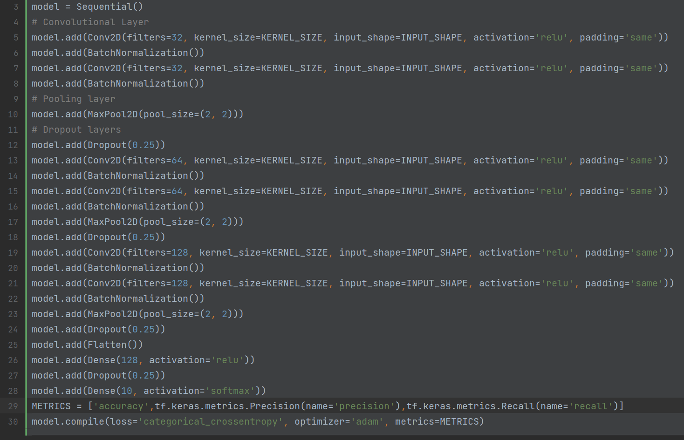
METHODOLOGY
Building and Training CNN classifier (Final Modified Model Accuracy 85.11%)

Slide 13
ALGORITHM USED IN PROPOSED SYSTEM
Random Forest Classifier is an ensemble learning method that combines multiple decision trees to create a model that can classify data points.
CNN is a deep learning architecture that uses multiple layers of convolutional, pooling, and activation functions to learn and extract features from images.
The pre-processing required in a ConvNet is much lower as compared to other classification algorithms. While in primitive methods filters are hand-engineered, with enough training, ConvNets have the ability to learn these filters/characteristics.
A ConvNet is able to successfully capture the Spatial and Temporal dependencies in an image through the application of relevant filters.
CNNs have been shown to achieve state-of-the-art results on large image classification datasets such as ImageNet and can handle complex features and patterns that may not be captured by other methods such as Random Forest Classifier.

Slide 14
Advantages and applications of image classification model using CNN:
The role of ConvNet is to reduce the images into a form that is easier to process, without losing features that are critical for getting a good prediction.
Highly Accurate and End to End learning - CNNs are highly accurate in classifying images and they can learn features directly from the raw pixel data, without the need for manual feature extraction and they are robust to variations in the input data.
CNN image classification models can be used to enhance children's education in various ways. Here are some ways how:
Visual learning: Children learn better when they can see and interact with objects. With the help of CNN image classification models, children can learn about different objects and their characteristics. For example, they can learn about different types of animals, fruits, vegetables, vehicles, and so on.
Gamification: Gamification is an effective way to engage children in learning. CNN image classification models can be integrated with educational games to make learning more fun and interactive. For example, a game can ask children to identify different types of animals, and the CNN model can provide feedback on their accuracy.

Slide 15
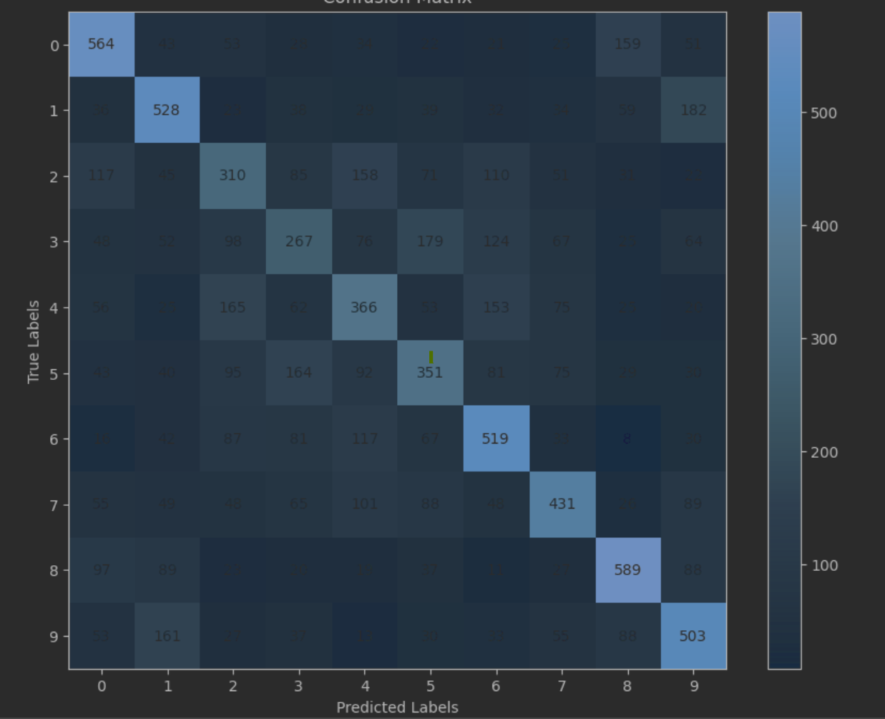
Results and Conclusion:
Random Forest classifier achieves an overall accuracy of 44% on the test data. Looking at the precision, recall, and f1-score metrics, we can see that the model is performing relatively poorly for most of the classes, with the exception of classes Airplane, Automobile, Frog, and Ship.

Slide 16
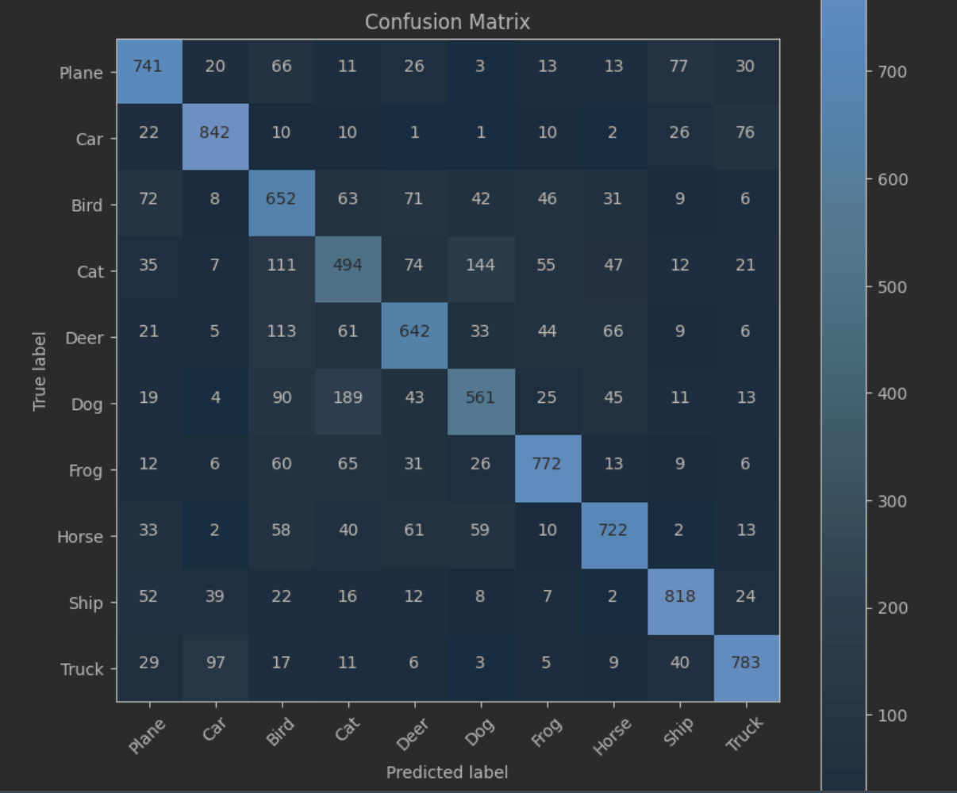
Results and Conclusion:
Convolutional Neural Network (CNN) base model achieves an overall accuracy of 70% on the test data. The model is performing significantly better than the Random Forest classifier, with a higher overall accuracy and better precision, recall, and f1-score metrics for most of the classes.

Slide 17
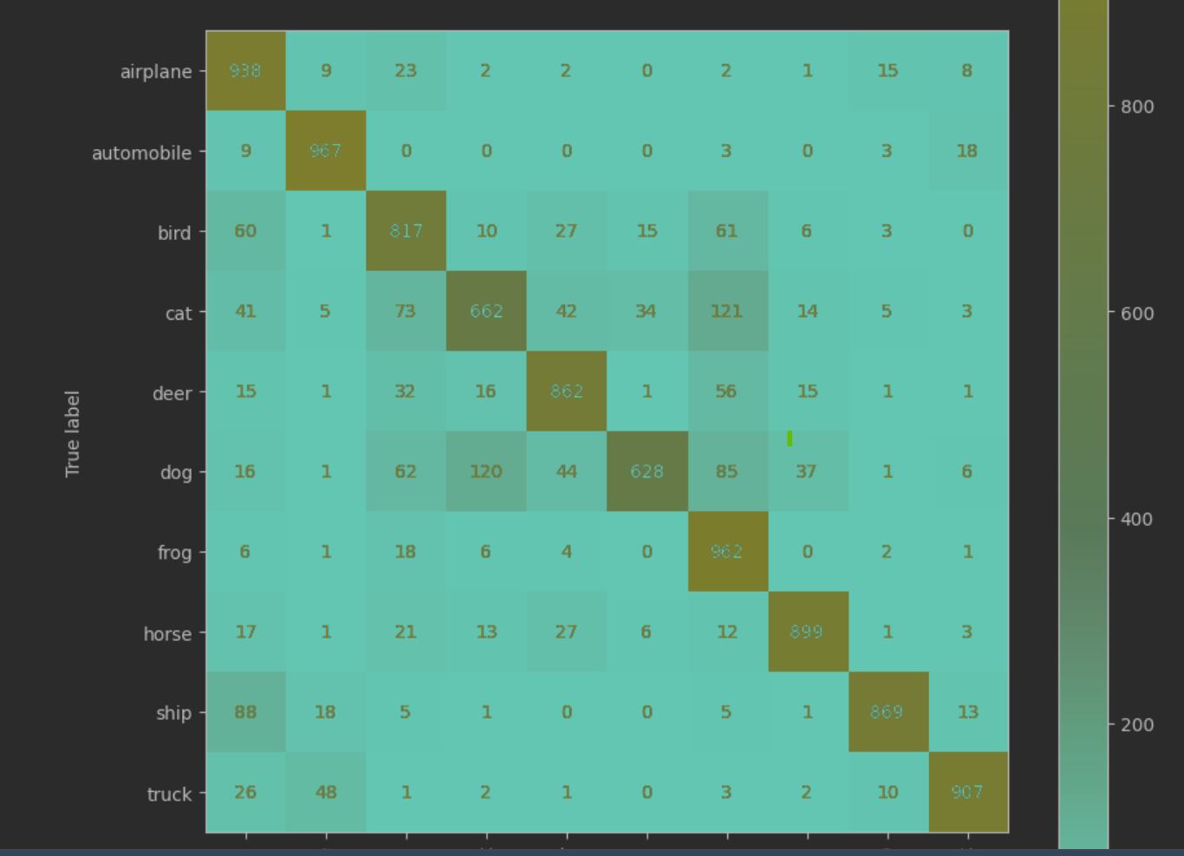
Results and Conclusion:
An improved version of the CNN model achieves an overall accuracy of 85% on the test data. This model is performing significantly better than the previous two models, with the highest overall accuracy and the best precision, recall, and f1-score metrics for most of the classes.

Slide 18
Future Enhancements of our current CNN model:
The Model can be used for the purpose of customizable way of helping differently gifted children to learn about different objects their characteristics for examples like animals its type, their life span, its terrain other interesting characteristics or buildings the general material used why they are used etc.
A simple application can be developed using mobile camera if image is scanned or user can choose from pre captured images the user interface should produce resulting data of the image the model identified but in a customized way
For achieving that the model should be enhanced to predict the objects more accurately even in different condition of image (shadow, angle, partial blocking, etc) and the result should be given at fastest pace as possible so the background functionalities could respond with linked data of that object identified.

Slide 19
REFERENCES
Krizhevsky, A., & Hinton, G. (2009). Learning multiple layers of features from tiny images. University of Toronto, Tech. Rep, 1(4).
This paper introduces the CIFAR-10 dataset and presents a deep learning approach using Convolutional Neural Networks (CNNs) for image classification.
fastai - Welcome to fastai. (n.d.). https://docs.fast.ai/
Keras documentation: https://keras.io/examples/cifar10_cnn/
TensorFlow documentation: https://www.tensorflow.org/tutorials/images/cn
Simonyan, K., & Zisserman, A. (2014). Very deep convolutional networks for large-scale image recognition. arXiv preprint arXiv:1409.1556.

